Slide 1
Spin-fluctuator Model

Slide 2
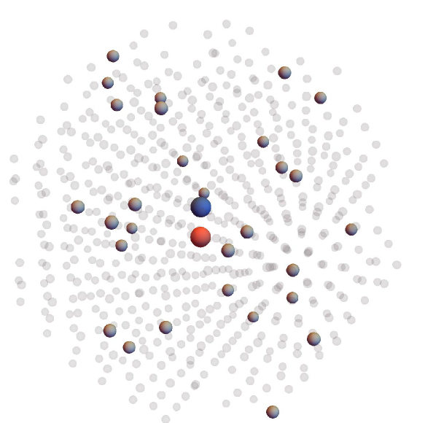
Experimental Values:
Orientation of diamond sample: (100)
Wavelength of laser: 532nm
Laser power: 4 W
Beam diameter: 4mm
Applied magnetic field: 30mT (lab frame)
Concentration of NV centers: 1ppm
NV:13C=1:10^4, and P1 centers= 20ppm
N
¹³C
Vacancy
¹²C

Slide 3
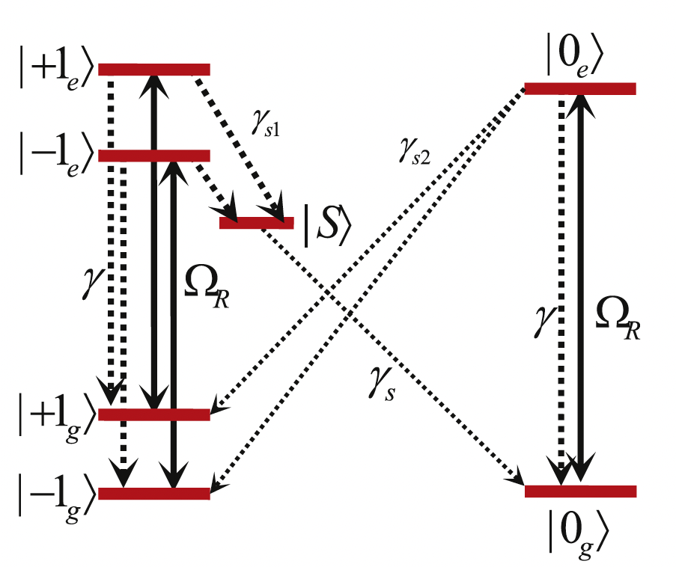

Spin-fluctuator model
NV Center: fluctuator
$${\hat{H}}_{e}=∆{\hat{σ}}_{e,e}+{\hat{H}}_{gs}+{\hat{H}}_{es}+\frac{Ω_{R}}{2}\left({\hat{σ}}_{e,g}+h.c.\right)$$
${\hat{H}}_{gs}=D_{gs}{\hat{S}}_{g,z}^{2}+γ_{e}B.{\hat{S}}_{g}$: ground state triplet
${\hat{H}}_{es}=D_{es}{\hat{S}}_{e,z}^{2}+γ_{e}B.{\hat{S}}_{e}$: excited state triplet
$∆$=detuning of optical pumping
$Ω_{R}$=Rabi frequency
P. wang et al. NJP. 17, 113041 (2015)

Slide 4
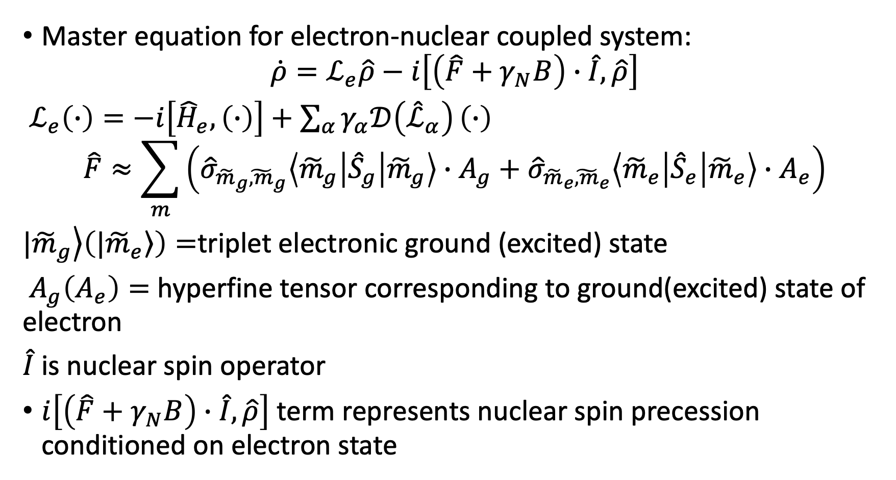
Spin-fluctuator model
Master equation for electron-nuclear coupled system:
$$\dot{ρ}=ℒ_{e}\hat{ρ}−i\left[\left(\hat{F}+γ_{N}B\right)∙\hat{I},\hat{ρ}\right]$$
$ℒ_{e}\left(∙\right)=−i\left[{\hat{H}}_{e},\left(∙\right)\right]+\sum_{α}{γ_{α}𝒟\left({\hat{ℒ}}_{α}\right)}\left(∙\right)$
$$\hat{F}≈\sum_{m}{\left({\hat{σ}}_{{\tilde{m}}_{g}{\tilde{,m}}_{g}}\left\langle {\tilde{m}}_{g} | {\hat{S}}_{g} | {\tilde{m}}_{g}\right\rangle ∙A_{g}+{\hat{σ}}_{{\tilde{m}}_{e}{\tilde{,m}}_{e}}\left\langle {\tilde{m}}_{e} | {\hat{S}}_{e} | {\tilde{m}}_{e}\right\rangle ∙A_{e}\right)}$$
$\left.{|\tilde{m}}_{g}\right\rangle \left(\left.{|\tilde{m}}_{e}\right\rangle \right)=$triplet electronic ground (excited) state
$A_{g}\left(A_{e}\right)=$ hyperfine tensor corresponding to ground(excited) state of electron
$\hat{I}$ is nuclear spin operator
$i\left[\left(\hat{F}+γ_{N}B\right)∙\hat{I},\hat{ρ}\right]$ term represents nuclear spin precession conditioned on electron state

Slide 5
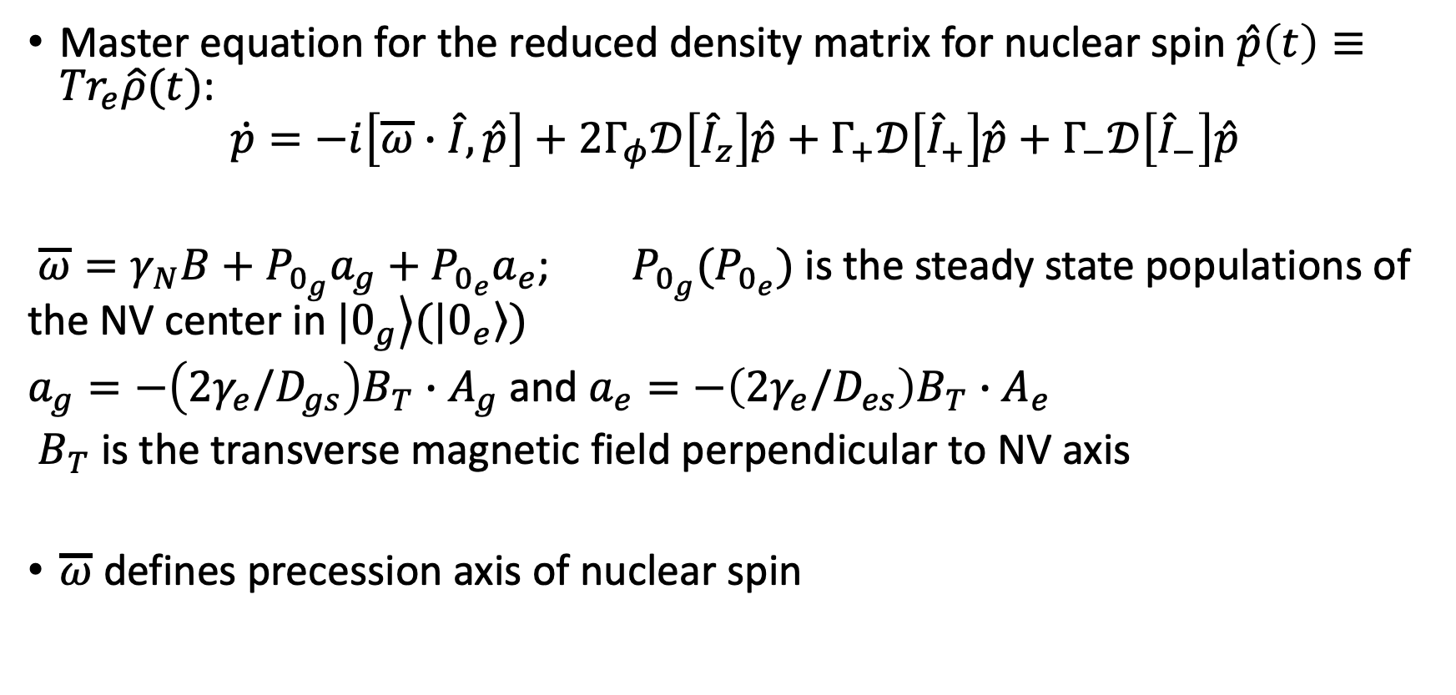
Spin-fluctuator model
Master equation for the reduced density matrix for nuclear spin $\hat{p}\left(t\right)≡{Tr}_{e}\hat{ρ}(t)$:
$$\dot{p}=−i\left[\overline{ω}∙\hat{I},\hat{p}\right]+2Γ_{φ}𝒟\left[{\hat{I}}_{z}\right]\hat{p}+Γ_{+}𝒟\left[{\hat{I}}_{+}\right]\hat{p}+Γ_{−}𝒟\left[{\hat{I}}_{−}\right]\hat{p}$$
$\overline{ω}=γ_{N}B+P_{0_{g}}a_{g}+P_{0_{e}}a_{e}$; $P_{0_{g}}(P_{0_{e}})$ is the steady state populations of the NV center in $|\left.0_{g}\right\rangle (|\left.0_{e}\right\rangle )$
$a_{g}=−\left(2γ_{e}/D_{gs}\right)B_{T}∙A_{g}$ and $a_{e}=−\left(2γ_{e}/D_{es}\right)B_{T}∙A_{e}$
$B_{T}$ is the transverse magnetic field perpendicular to NV axis
$\overline{ω}$ defines precession axis of nuclear spin

Slide 6
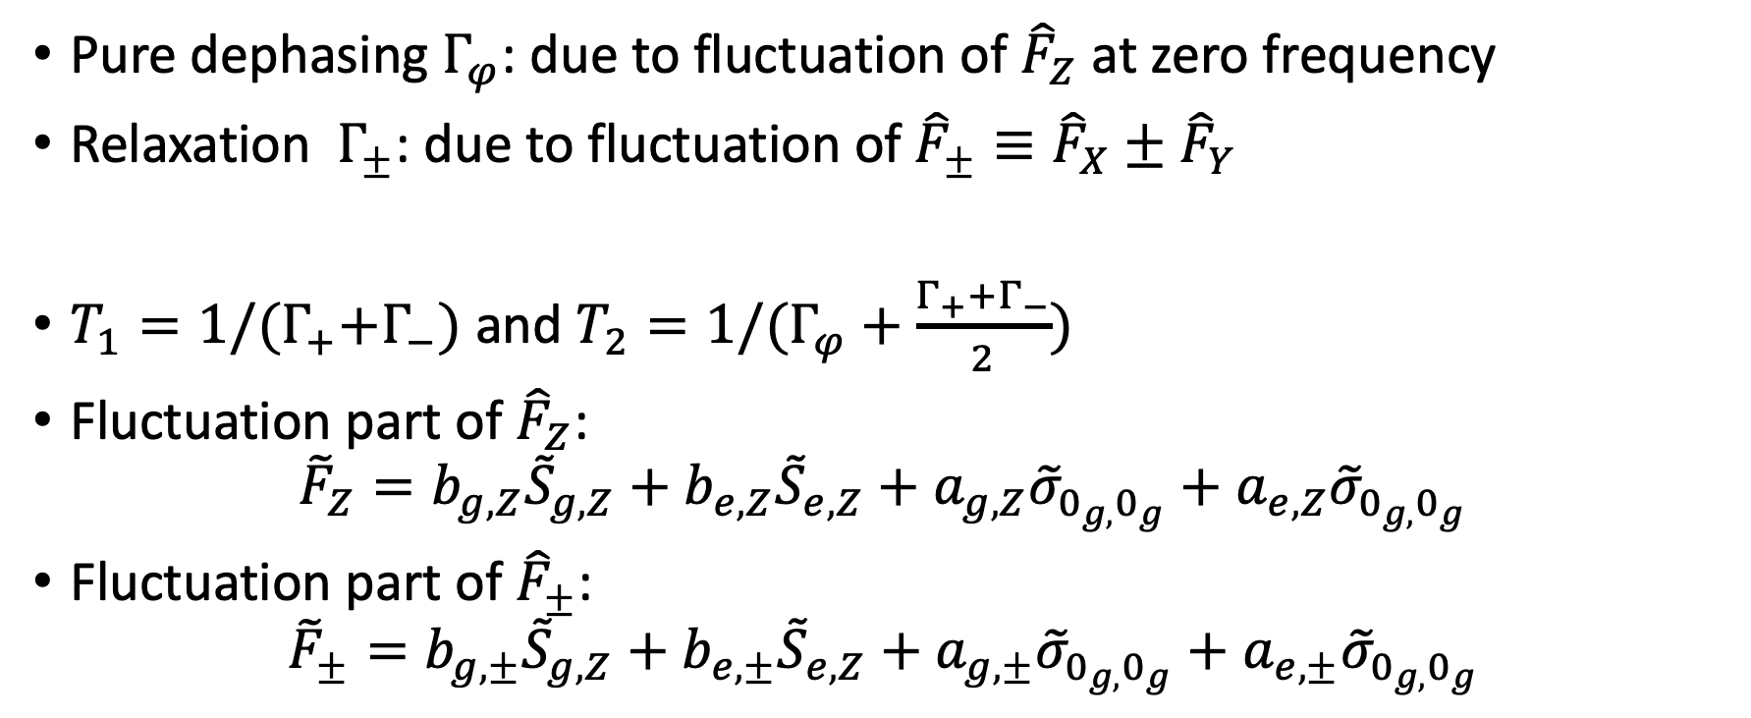
Nuclear spin decoherence
Pure dephasing $Γ_{φ}$: due to fluctuation of ${\hat{F}}_{Z}$ at zero frequency
Relaxation $Γ_{±}$: due to fluctuation of ${\hat{F}}_{±}≡{\hat{F}}_{X}±{\hat{F}}_{Y}$
$T_{1}=1/(Γ_{+}{+Γ}_{−})$ and $T_{2}=1/(Γ_{φ}+\frac{Γ_{+}{+Γ}_{−}}{2})$
Fluctuation part of ${\hat{F}}_{Z}$:
$${\tilde{F}}_{Z}=b_{g,Z}{\tilde{S}}_{g,Z}+b_{e,Z}{\tilde{S}}_{e,Z}+a_{g,Z}{\tilde{σ}}_{0_{g,}0_{g}}+a_{e,Z}{\tilde{σ}}_{0_{g,}0_{g}}$$
Fluctuation part of ${\hat{F}}_{±}$:
$${\tilde{F}}_{±}=b_{g,±}{\tilde{S}}_{g,Z}+b_{e,±}{\tilde{S}}_{e,Z}+a_{g,±}{\tilde{σ}}_{0_{g,}0_{g}}+a_{e,±}{\tilde{σ}}_{0_{g,}0_{g}}$$

Slide 7
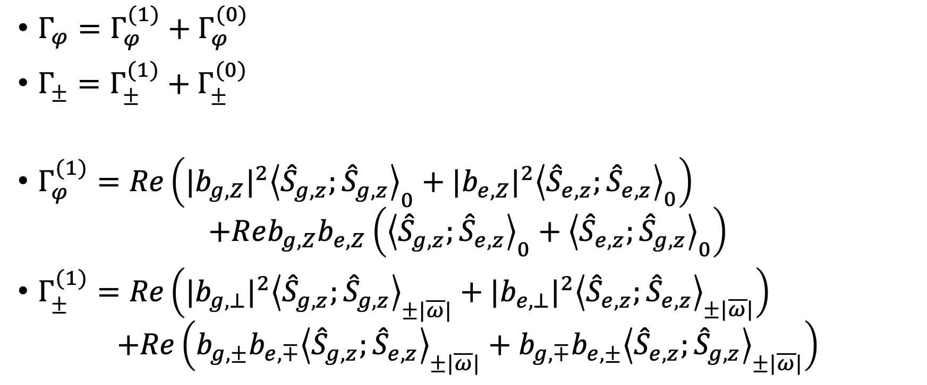
Nuclear spin decoherence
$Γ_{φ}=Γ_{φ}^{(1)}+Γ_{φ}^{(0)}$
$Γ_{±}=Γ_{±}^{(1)}+Γ_{±}^{(0)}$
$Γ_{φ}^{(1)}=Re\left({|b_{g,Z}|}^{2}{\left\langle {\hat{S}}_{g,z};{\hat{S}}_{g,z}\right\rangle }_{0}+{|b_{e,Z}|}^{2}{\left\langle {\hat{S}}_{e,z};{\hat{S}}_{e,z}\right\rangle }_{0}\right)$
$$+Reb_{g,Z}b_{e,Z}\left({\left\langle {\hat{S}}_{g,z};{\hat{S}}_{e,z}\right\rangle }_{0}+{\left\langle {\hat{S}}_{e,z};{\hat{S}}_{g,z}\right\rangle }_{0}\right)$$
$Γ_{±}^{(1)}=Re\left({|b_{g,⊥}|}^{2}{\left\langle {\hat{S}}_{g,z};{\hat{S}}_{g,z}\right\rangle }_{±|\overline{ω}|}+{|b_{e,⊥}|}^{2}{\left\langle {\hat{S}}_{e,z};{\hat{S}}_{e,z}\right\rangle }_{±|\overline{ω}|}\right)$
$$+Re\left({b_{g,±}b_{e,∓}\left\langle {\hat{S}}_{g,z};{\hat{S}}_{e,z}\right\rangle }_{±|\overline{ω}|}+{b_{g,∓}b_{e,±}\left\langle {\hat{S}}_{e,z};{\hat{S}}_{g,z}\right\rangle }_{±|\overline{ω}|}\right)$$

Slide 8
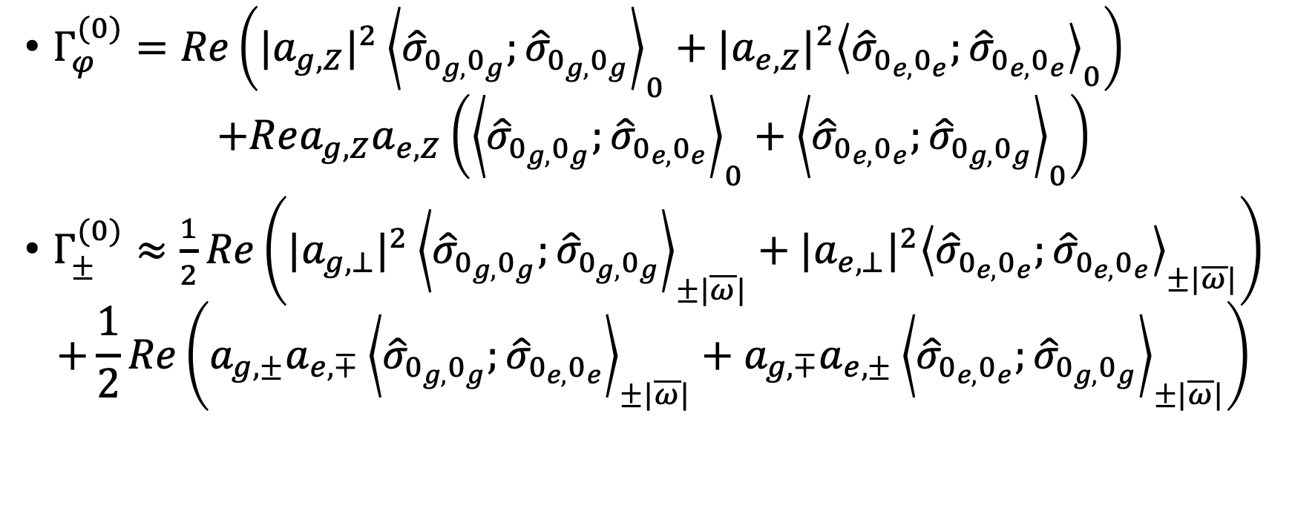
Nuclear spin decoherence
$Γ_{φ}^{(0)}=Re\left({|a_{g,Z}|}^{2}{\left\langle {\hat{σ}}_{0_{g,}0_{g}};{\hat{σ}}_{0_{g,}0_{g}}\right\rangle }_{0}+{|a_{e,Z}|}^{2}{\left\langle {\hat{σ}}_{0_{e,}0_{e}};{\hat{σ}}_{0_{e,}0_{e}}\right\rangle }_{0}\right)$
$$+Rea_{g,Z}a_{e,Z}\left({\left\langle {\hat{σ}}_{0_{g,}0_{g}};{\hat{σ}}_{0_{e,}0_{e}}\right\rangle }_{0}+{\left\langle {\hat{σ}}_{0_{e,}0_{e}};{\hat{σ}}_{0_{g,}0_{g}}\right\rangle }_{0}\right)$$
$Γ_{±}^{(0)}≈\frac{1}{2}Re\left({|a_{g,⊥}|}^{2}{\left\langle {\hat{σ}}_{0_{g,}0_{g}};{\hat{σ}}_{0_{g,}0_{g}}\right\rangle }_{±|\overline{ω}|}+{|a_{e,⊥}|}^{2}{\left\langle {\hat{σ}}_{0_{e,}0_{e}};{\hat{σ}}_{0_{e,}0_{e}}\right\rangle }_{±|\overline{ω}|}\right)$
$$+\frac{1}{2}Re\left({a_{g,±}a_{e,∓}\left\langle {\hat{σ}}_{0_{g,}0_{g}};{\hat{σ}}_{0_{e,}0_{e}}\right\rangle }_{±|\overline{ω}|}+{a_{g,∓}a_{e,±}\left\langle {\hat{σ}}_{0_{e,}0_{e}};{\hat{σ}}_{0_{g,}0_{g}}\right\rangle }_{±|\overline{ω}|}\right)$$

Slide 9
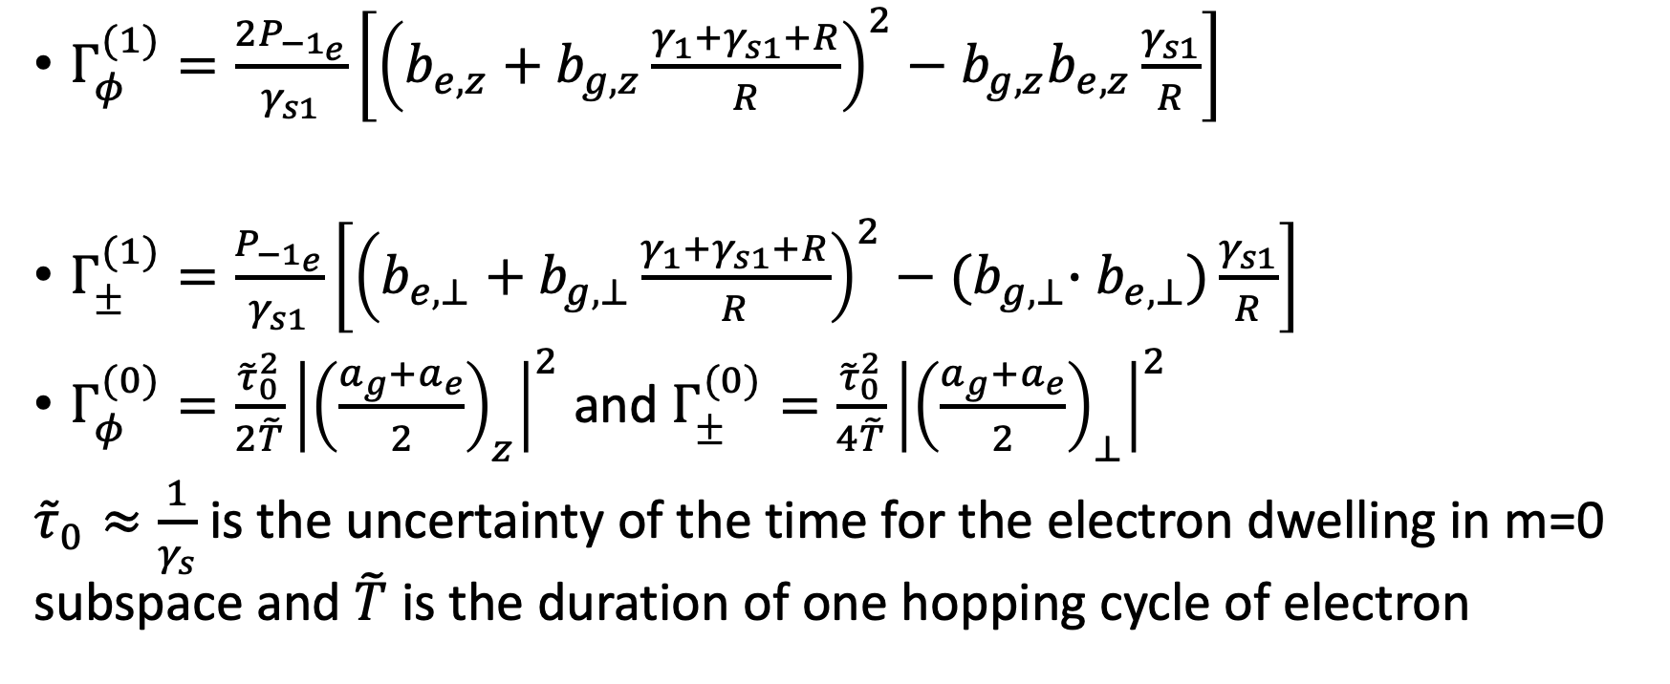
Nuclear spin decoherence
$Γ_{φ}^{(1)}=\frac{2P_{{−1}_{e}}}{γ_{s1}}\left[{\left(b_{e,z}+b_{g,z}\frac{γ_{1}+γ_{s1}+R}{R}\right)}^{2}−b_{g,z}b_{e,z}\frac{γ_{s1}}{R}\right]$
$Γ_{±}^{(1)}=\frac{P_{{−1}_{e}}}{γ_{s1}}\left[{\left(b_{e,⊥}+b_{g,⊥}\frac{γ_{1}+γ_{s1}+R}{R}\right)}^{2}−{(b}_{g,⊥}∙b_{e,⊥})\frac{γ_{s1}}{R}\right]$
$Γ_{φ}^{(0)}=\frac{{\tilde{τ}}_{0}^{2}}{2\tilde{T}}{\left|{\left(\frac{a_{g}+a_{e}}{2}\right)}_{z}\right|}^{2}$ and $Γ_{±}^{(0)}=\frac{{\tilde{τ}}_{0}^{2}}{4\tilde{T}}{\left|{\left(\frac{a_{g}+a_{e}}{2}\right)}_{⊥}\right|}^{2}$
${\tilde{τ}}_{0}≈\frac{1}{γ_{s}}$ is the uncertainty of the time for the electron dwelling in m=0 subspace and $\tilde{T}$ is the duration of one hopping cycle of electron

Slide 10
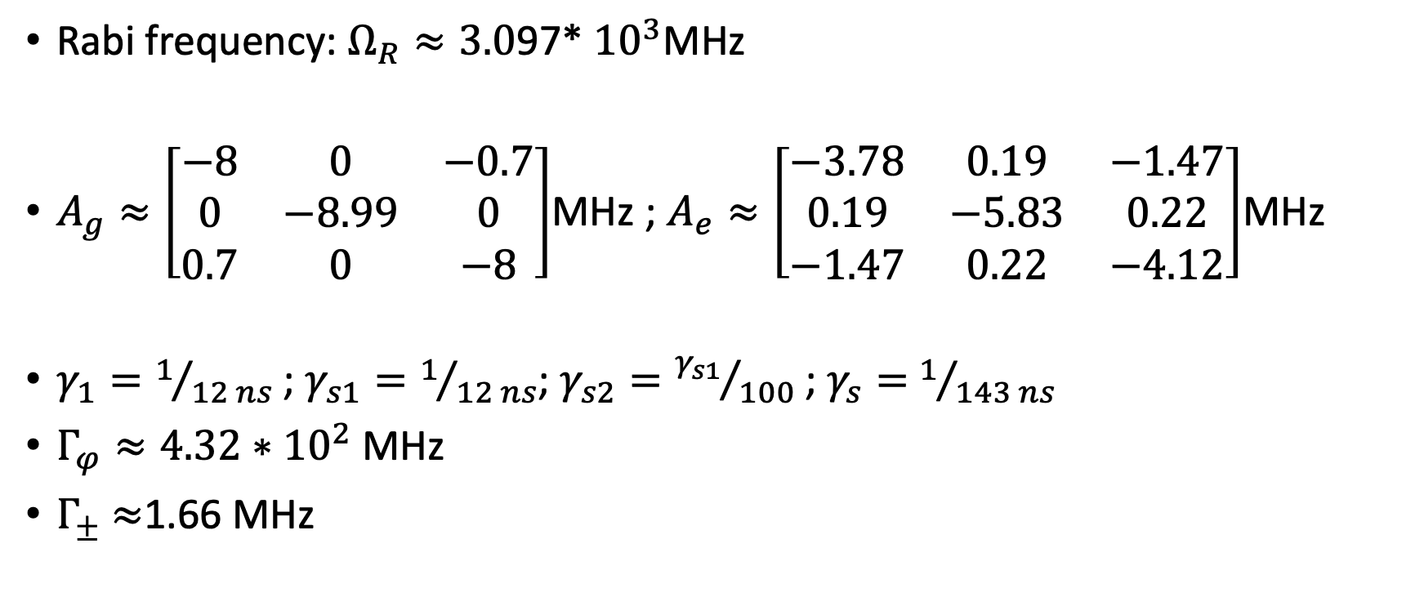
Numerical results:
Rabi frequency: $Ω_{R}≈3.0$97* ${10}^{3}$MHz
$A_{g}≈\left[\begin{matrix}−8 & 0 & −0.7 \\ 0 & −8.99 & 0 \\ 0.7 & 0 & −8\end{matrix}\right]$MHz ; $A_{e}≈\left[\begin{matrix}−3.78 & 0.19 & −1.47 \\ 0.19 & −5.83 & 0.22 \\ −1.47 & 0.22 & −4.12\end{matrix}\right]$MHz
$γ_{1}=1/{12 ns}$; $γ_{s1}=1/{12 ns}$; $γ_{s2}={γ_{s1}}/{100}$ ; $γ_{s}=$ $1/{143 ns}$
$Γ_{φ}≈4.32∗{10}^{2}$MHz
$Γ_{±}$ $≈$1.66 MHz

Slide 11
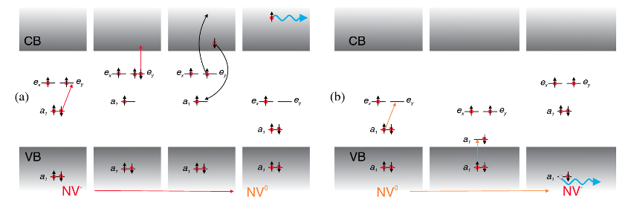
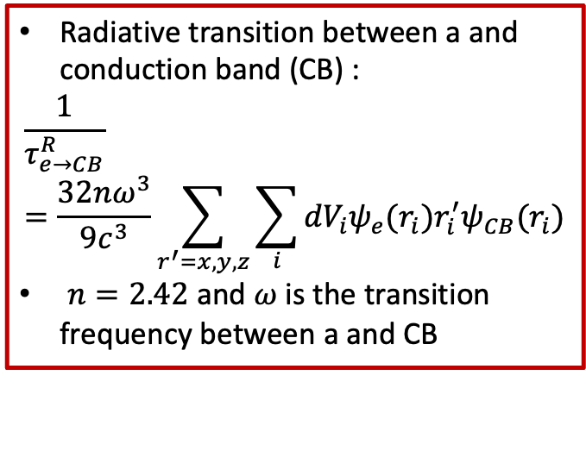
NV center decoherence
Indirect excitation involving diamond CB and Valence band
Radiative transition between a and conduction band (CB) :
$$\frac{1}{τ_{e→CB}^{R}}=\frac{32nω^{3}}{9c^{3}}\sum_{r^{′}=x,y,z}{\sum_{i}{{dV}_{i}ψ_{e}{(r_{i})r}_{i}^{′}ψ_{CB}(r_{i})}}$$
$n=2.42$ and $ω$ is the transition frequency between a and CB
Fig: Charge conversion process for negative and neutral states of the NV defect
P. Siysshev et al. PRL 110, 167402(2013)

Slide 12
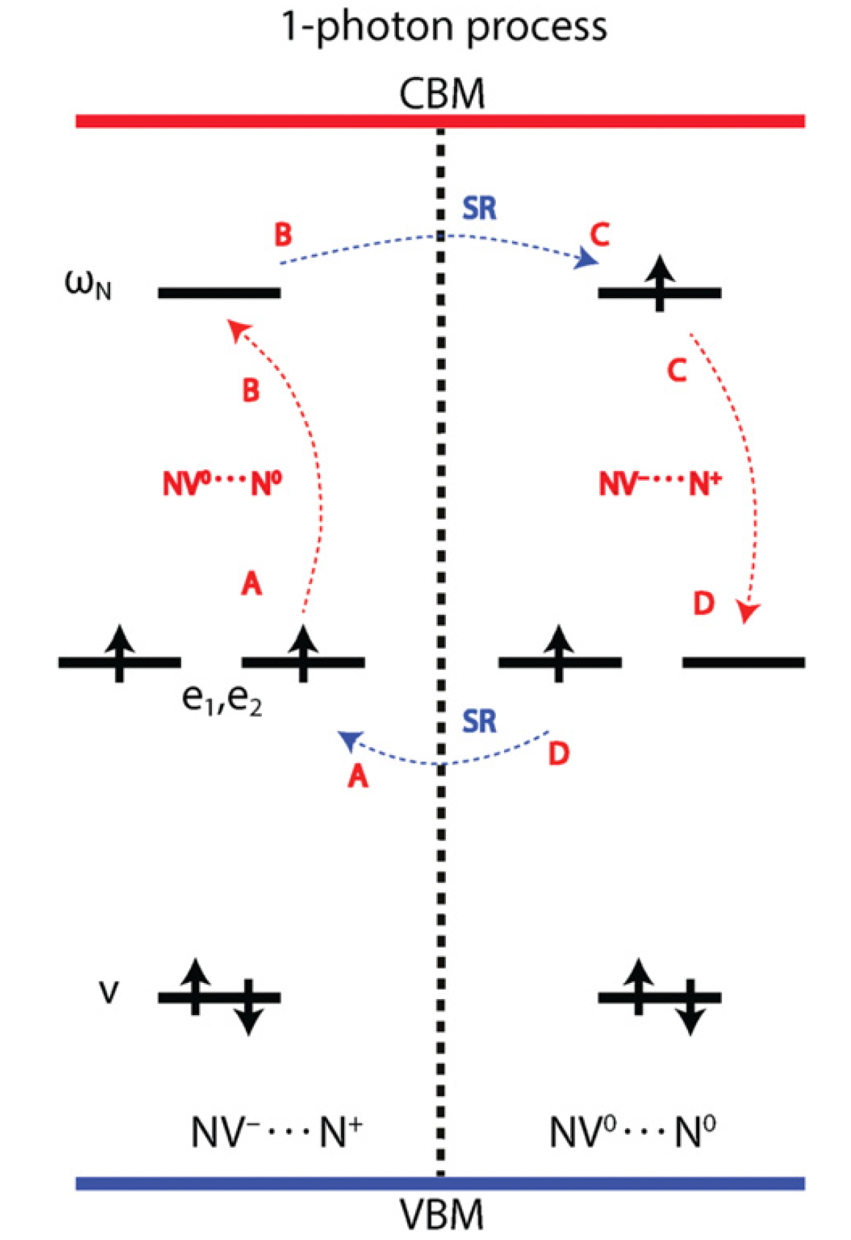
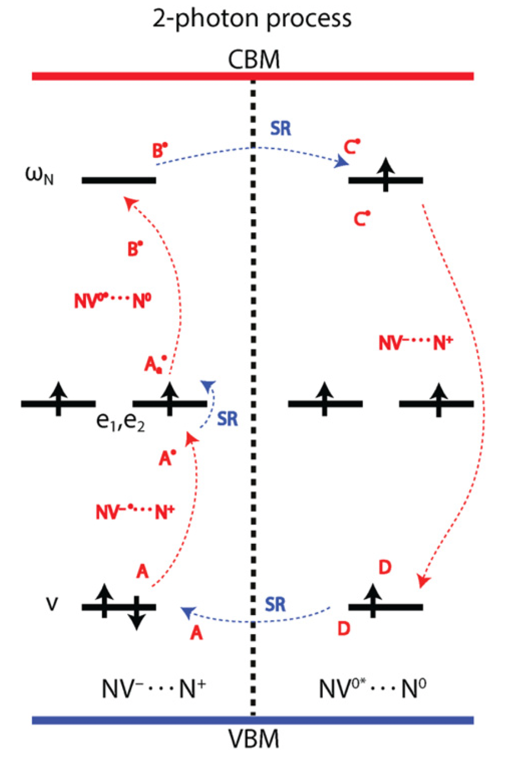

NV center decoherence
Electronic excitations directly between the NV center and a donor –N
R. L$\ddot{o}$fgren et al. New J. Phys. 22, 123042(2020)

Slide 13
NV center decoherence
The excitation from NV⁻ GS to donor N⁺ in one-photon process requires 2.31eV
The excitation to the neutral state can be achieve through a sequential two-photon process with the 1st step at 2.19 eV and 2nd step at 0.81 eV

